Slide 1

Travelog
당신을 위한 여행기록

Slide 2

목차
1.개발 배경
2.개발 목표
3.개발 효과
4.관련 연구 및 사례
6.시스템 구성도
5.시스템 수행 시나리오
7.개발환경
8.업무분담
9.수행일정
10.깃헙주소

Slide 3

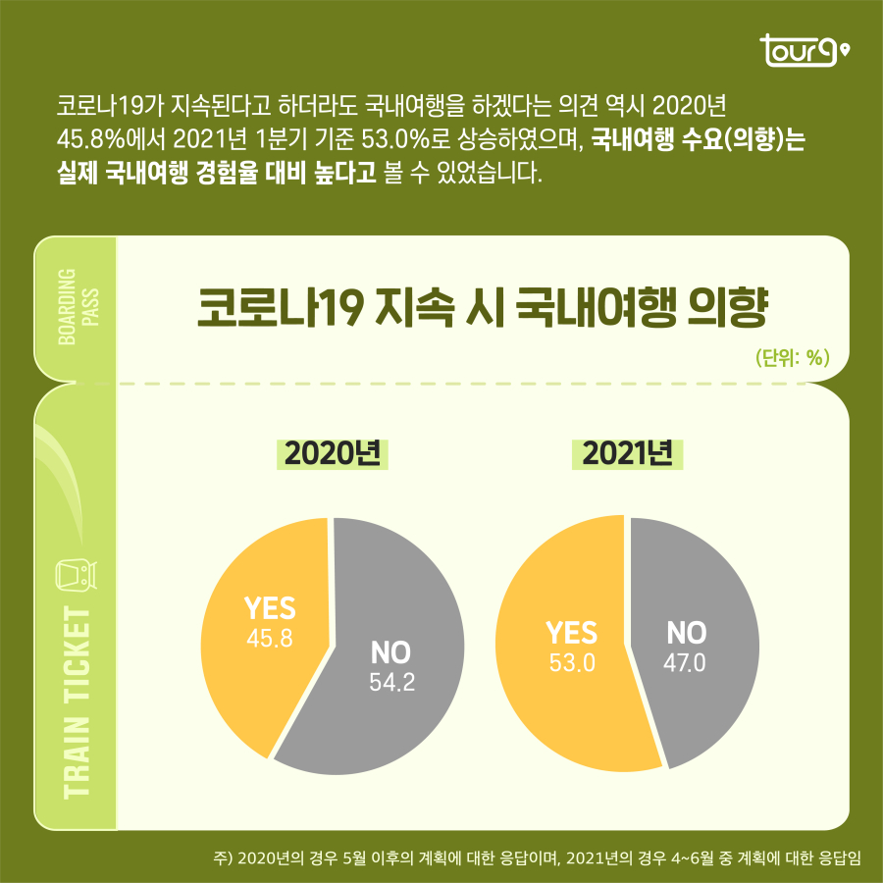
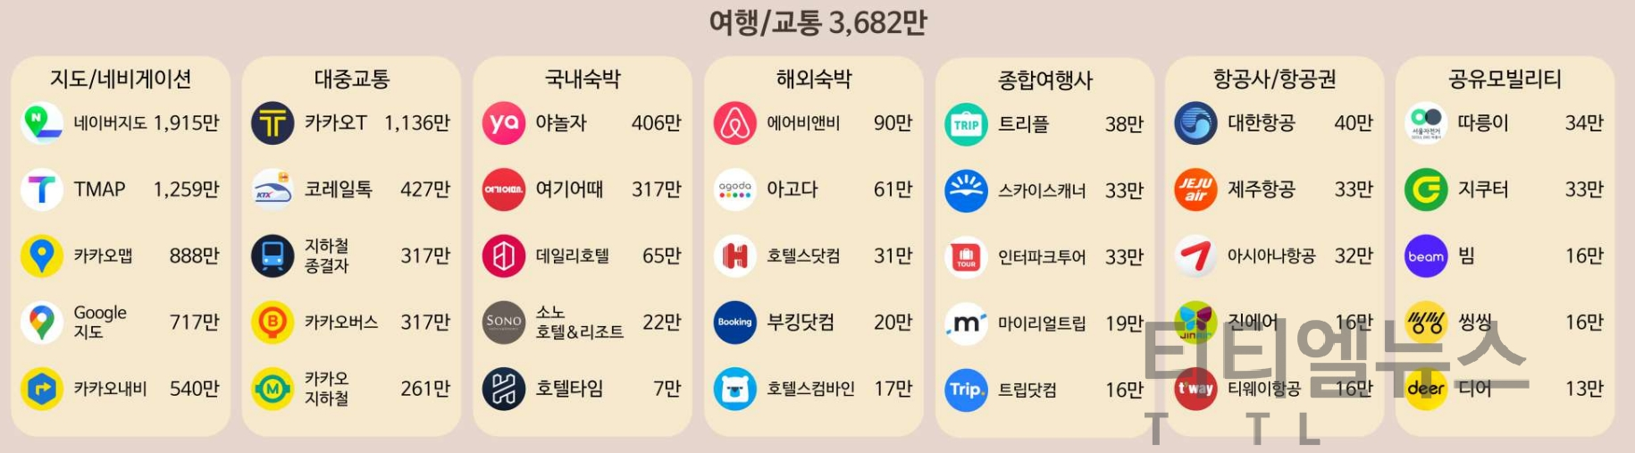
1.개발 배경
코로나로 인해 국내여행 비율이 이전보다 늘어난 상태
코로나에 의한 규제가 점점 풀리면서 여행에 대한 수요가 늘어남
지출 내역 및 방문 장소기록,
여행 일지 등 여행하는 동안
사용자가 편리하고 유용하게
사용할 수 있는 앱은 찾기
어려움
숙박 시설 정보나 교통 등
여행 수단 및 도구에 초점을
맞춘 앱들은 현재 많음.

Slide 4
2.개발 목표
1
여행하는 동안에 경비,장소를기록하고 이에 대한 일지를 작성할 수 있도록 한다.
동행자가 있을 경우 여행지사진들을 앱 내에서 쉽게 공유할 수 있도록 한다.
2
3
영수증을 이용하여 여행 경비 및 다녀간 장소들을 더욱 쉽게 기록할 수 있도록 한다.
4
여행자가 여행하는 동안에 편리하고 유용하게 사용할 수 있는 앱을
개발하는 것을 목표로 한다.

Slide 5
3.개발 효과
영수증 OCR을 통한 자동문자 입력으로 여행하는 동안 더 간편하게
방문 장소 및 지출 내역을 기록을 할 수 있다.
영수증을 통한 정산기능으로 여행비용을 꼼꼼하고 쉽게 계산할 수 있다.
여행에 대한 사진과 글귀를 함께 작성하며 추억을 공유할 수 있다.

Slide 6
4.관련 연구 및 사례
기존 서비스와 비교
 | 트립어드바이저 | 트리플 | 트래블로그
여행 일지 작성 | O | O | O
여행 동행자 초대 | O | O | O
여행 사진 업로드 | X | O | O
지도 시각화 | O | O | O
가계부 | X | O | O
정산 | X | O | O
OCR | X | X | O

Slide 7




5.시스템 시나리오
여행 기록 데이터 전송
여행 기록, 여행지 데이터 갱신
방문 장소, 상세내역 및
금액 추출
사용자
업데이트 된 데이터 전송
요청 엔터티 제공
DB
영수증 OCR
서버
지도에 여행 기록 표시
여행비 기록
동행자 태그
사용자의 여행 기록 데이터에서 키워드 추출 후 여행지에 대한 설명 추가
사용자가 기록한 데이터를 이용하여 여행지마다 방문 순위 리스트 저장

Slide 8
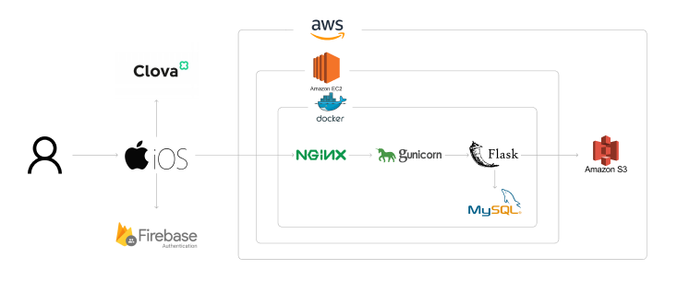
6.시스템 구성도

Slide 9
7.개발 환경
개발 언어 | Swift, Python
서버 | Nginx, gunicorn, Flask
DB | MySQL
주요 라이브러리 | Naver Clova
Infra | AWS, S3, Docker, Jenkins
개발 방법론 | 애자일
협업 및 기타 도구 | Jira, Git, GitHub, Figma

Slide 10
8.업무분담
팀원 | 성명 | 학번 | 주요 역할
 | 이승현 | 2017144027 | PM, iOS 개발, UI/UX 디자인, 인프라 설계
 | 이정동 | 2018158026 | iOS 개발, 서버 구현, DB 설계
 | 박준희 | 2018158015 | iOS 개발, 서버 구현, DB 설계
 | 박다미 | 2020316017 | iOS 개발, UI/UX 디자인, 인프라 설계

Slide 11
9.깃허브 주소
Github 주소
https://github.com/tukcom2023CD/BOSS

Slide 12
10.수행일정
 |  | 2022.12 | 2023.1 | 2023.2 | 2023.3 | 2023.4 | 2023.5 | 2023.6 | 2023.7 | 2023.8 | 2023.9
요구사항 정의 및 분석 | 문제정의 및 분석
 | 요구사항 명세
 | 제안서 및 계획서 작성
시스템 설계 및 시나리오 구성 | 시스템 상세 설계
 | 시나리오 검토
세부 설계 및 구현 | 프로토타입 모델 개발
 | 개발 Infra구축
 | UI/UX 디자인
 | 어플리케이션 개발
시험 및 데모 | 시스템 통합 테스트
 | 시제품 데모
최종 데모 및 출품 | 최종 데모
최종 보고서 | 최종 보고서 작성

Slide 13
감사합니다.

Slide 14
이 후 슬라이드 무시해주세요

Slide 15
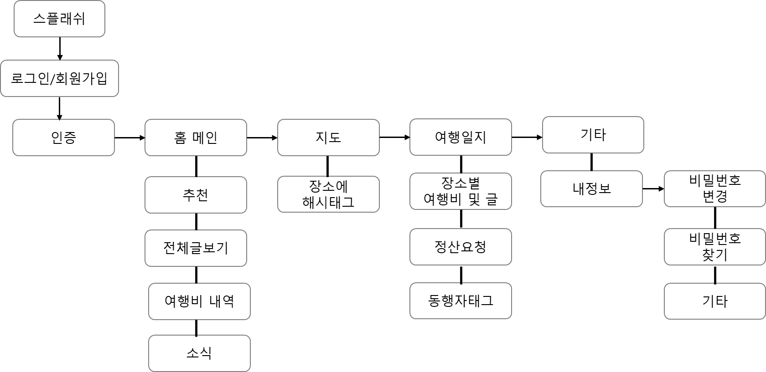
5.시스템 시나리오

Slide 16
관련 연구 및 사례
코로나로 인한 여행자 실태조사
2021 모바일 앱 랜드스케이프’의 모바일 앱 업종별 사용자 수 TOP5에 따르면, 종합 여행사 부문
점점늘어나는 여행비율
트립어드바이저
https://www.tripadvisor.co.kr/pages/first_visit.html
트리플(가계부 기능은 없음)
여행앱 초첨

Slide 17

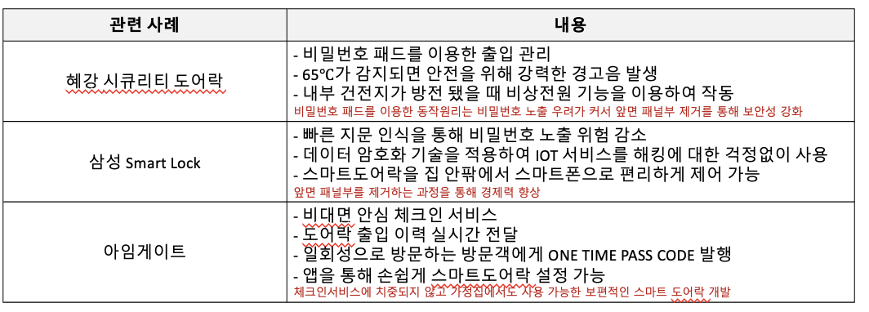
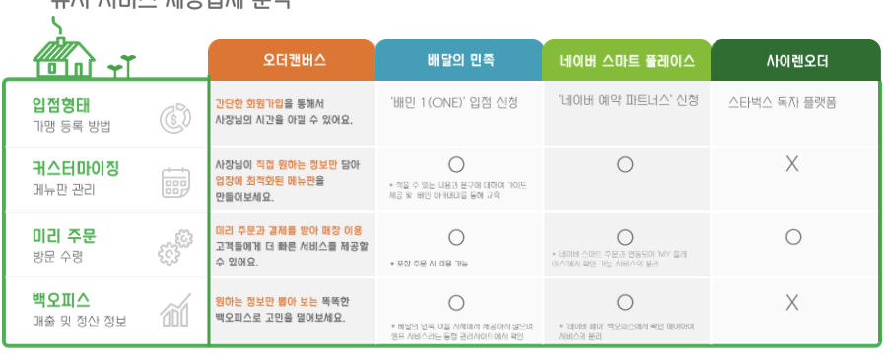
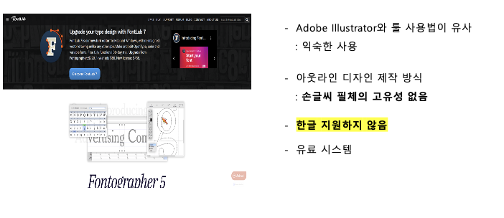
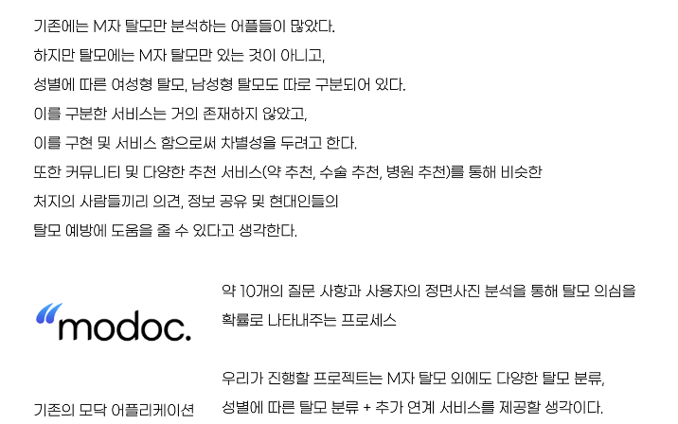
관련 연구 및 사례

Slide 18
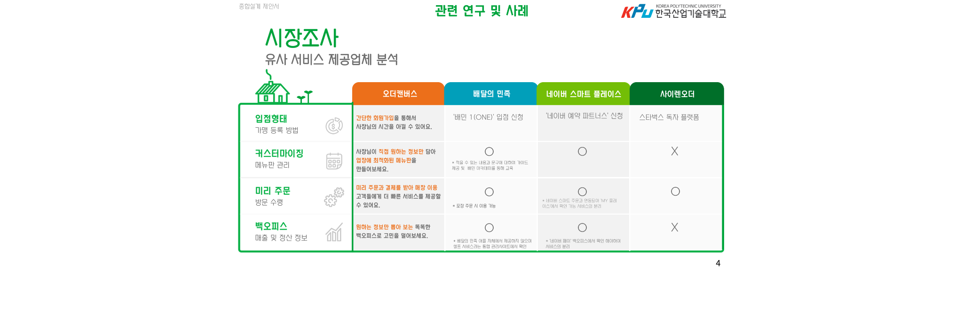
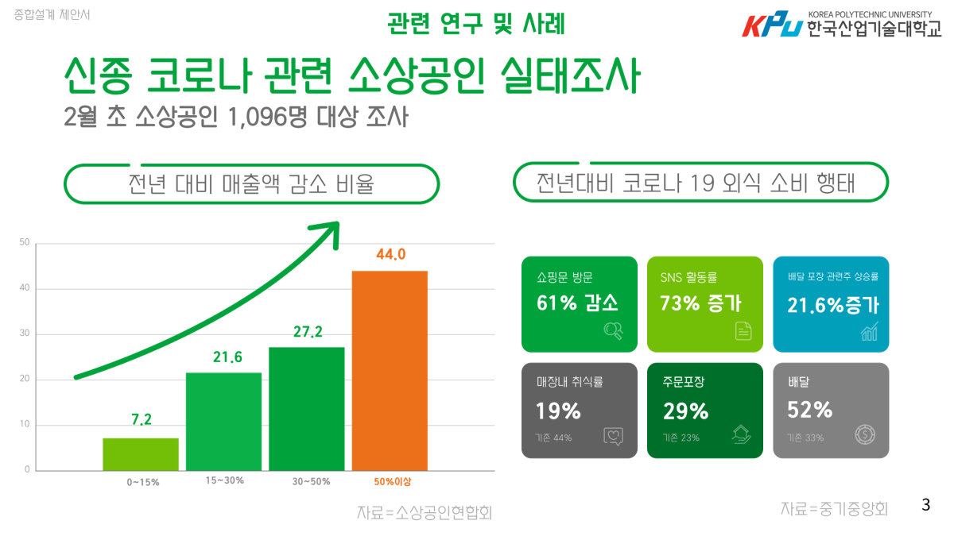
관련 연구 및 사례

Slide 19
Travel Infographics
01
02
03
04
TRAVEL
TOURISM
PLACES
THRIFT
Venus has a beautiful name and is hot
Mercury is the
closest planet to the Sun
Despite being red, Mars is a cold place
Jupiter is a gas giant and the biggest planet

Slide 20
Travel Infographics
$2,000
$4,500
$3,000
Mercury is the closest planet to the Sun and the smallest
Venus is the second planet from the Sun. It’s terribly hot
Jupiter is the biggest planet in the entire Solar System

Slide 21
Travel Infographics
DAYS | Mercury is the closest planet to the Sun
COST | Venus has a beautiful name, but it's hot
CONFORT | It’s the biggest planet in the Solar System
DAYS | Despite being red, Mars is cold
COST | Saturn is the ringed one and a gas giant
CONFORT | Neptune is the farthest planet from the Sun

Slide 22
Travel Infographics
100%
Mercury is the closest planet to the Sun and the smallest one in the Solar System
90%
Despite being red, Mars is a cold place. It’s full of iron oxide dust
65%
Yes, this is the ringed one. It’s a gas giant, composed mostly of hydrogen and helium
25%
Saturn, the ringed planet, is composed mostly of hydrogen and helium

Slide 23
Travel Infographics
MERCURY
SATURN
Mercury is the closest planet to the Sun
Saturn is the ringed one and a gas giant
06
01
VENUS
JUPITER
05
02
Venus has a beautiful name and is hot
Jupiter is a gas giant and the biggest planet
MARS
04
03
NEPTUNE
Despite being red, Mars is actually a cold place
It’s the farthest planet from the Sun

Slide 24
Travel Infographics
SWIMMING POOL
BEACH
RIVER
Despite being red, Mars is actually a cold place
Venus has a beautiful name and is the second planet
Mercury is the closest planet to the Sun and the smallest one
45%
2019
20%
2019
35%
2019

Slide 25
Travel Infographics
DESTINATION
Mercury is the closest planet to the Sun and the smallest one in the Solar System
PASSPORT
Despite being red, Mars is a cold place. It’s full of iron oxide dust
TICKET
It’s a gas giant and the biggest planet in our Solar System. It’s the fourth-brightest object in the sky

Slide 26
Travel Infographics
1 D
500$
22 D
100$
FLIGHTS
ROAD TRIPS
Mercury is the closest planet to the Sun and the smallest one in the Solar System
It’s a gas giant and the biggest planet in the Solar System. Jupiter is the fourth-brightest object
Venus has a beautiful name
Mercury is the
smallest planet
Mars is a cold place
Jupiter is a gas giant
Neptune is the
farthest planet
Saturn is the
ringed one

Slide 27
Travel Infographics
TRAVEL TO ITALY
1
2
3
4
5
6
7
Venus has a beautiful name and is hot
8
9
10
11
12
13
14
GREECE
Despite being red, Mars is a cold place
15
16
17
18
19
20
21
FREE TIME
22
23
24
25
26
27
28
Mercury is the closest planet to the Sun

Slide 28
Travel Infographics
ITALY
GREECE
FRANCE
Venus has a
beautiful name,
but it’s hot
Neptune is the
farthest planet
from the Sun
Saturn is the
ringed one and a gas giant
BRAZIL
SOUTH KOREA
CHINA
Despite being red, Mars is a cold place
Jupiter is a gas giant and the biggest planet
Mercury is the
closest planet to the Sun
100%
90%
80%
100%
80%
40%

Slide 29
Travel Infographics
PARIS
NEW YORK
KATHMANDU
AGRA
HANGZHOU
Venus has a beautiful name and is hot
Mercury is the
closest planet to the Sun
Despite being red, Mars is a cold place
Jupiter is a gas giant and the biggest planet
Neptune is the farthest planet from the Sun

Slide 30
Travel Infographics
 | SUITCASES | TICKET | PASSPORT
BUS
PLANE
TRAIN
SHIP

Slide 31
Travel Infographics
DINNER 1:00 PM
Jupiter is a gas giant and the biggest planet
MUSEUM 10:00 PM
Mercury is the closest planet to the Sun
TRAINS 8:30 PM
Despite being red, Mars is actually cold

Slide 32
Travel Infographics
45%
65%
Despite being red, Mars is actually cold
Mercury is the closest planet to the Sun
25%
85%
Jupiter is a gas giant and the biggest planet
Venus is the second planet from the Sun

Slide 33
Travel Infographics
AMERICAS
AUSTRALIA
Venus is the second planet from the Sun
It’s the biggest planet in the Solar System
35%
56%

Slide 34
Travel Infographics
WHAT
COUNTRY?
ITALY
GREECE
FRANCE
GERMANY
Mercury is the
closest planet to the Sun
Despite being red, Mars is a cold place
Jupiter is a gas giant and the biggest planet
Neptune is the farthest planet from the Sun

Slide 35
Travel Infographics
THRIFT
Mercury is the closest planet to the Sun
PLACES
Venus has a beautiful name, but also high temperatures
TOURISM
Jupiter is a gas giant and the biggest planet
TRAVEL
Despite being red, Mars is actually a cold place

Slide 36
Travel Infographics
ITALY
FRANCE
BELGIUM
Mercury is the closest planet to the Sun
Venus is the second planet from the Sun
Jupiter is a gas giant and the biggest planet
2016
2018
2019
2015
2017
2018
2020
CHINA
SOUTH KOREA
JAPAN
BRAZIL
Despite being red, Mars is a cold place
Earth is the planet where we live on
Neptune is the farthest planet from the Sun
Saturn is a gas giant and has several rings

Slide 37
Travel Infographics
50%
60%
85%
97%
SPRING
SUMMER
FALL
WINTER
Mercury is the closest planet to the Sun
Venus has a beautiful name and is hot
Despite being red, Mars is cold
Jupiter is a gas giant and the biggest planet

Slide 38
Travel Infographics
1
2
3
TRAVEL
CITY
PLACES
Mercury is the closest planet to the Sun and smallest one
Venus has a beautiful name and is the second planet
Despite being red, Mars is actually a really cold place

Slide 39
Travel Infographics
BEACH
MOUNTAIN
CITY
Mercury is the closest planet to the Sun
Venus has a beautiful name and is hot
Despite being red, Mars is actually cold
2
1
3

Slide 40
Travel Infographics
CITIE
1
3
RESTAURANTS
Mercury is the closest planet to the Sun
It’s a gas giant and the
biggest planet
MUSEUMS
2
4
MONUMENTS
Venus has a beautiful name and is hot
Despite being red, Mars is a really cold place

Slide 41
Travel Infographics
SUMMER
10%
30%
SPRING
Venus has a beautiful name and is the second planet
Neptune is the fourth-largest planet in the Solar System
25%
35%
WINTER
FALL
Mercury is the closest planet to the Sun and smallest one
Jupiter is the biggest planet in the entire Solar System

Slide 42
Travel Infographics
25%
45%
65%
TRAVEL BY SEA
TOURISM
GUIDE
It’s a gas giant and the biggest planet in the Solar System. Jupiter is the fourth-brightest
Mercury is the closest planet to the Sun and the smallest one in the Solar System
Venus has a beautiful name and is the second planet from the Sun. It’s terribly hot

Slide 43
Travel Infographics
65%
45%
CHINA
POLAND
Venus has a beautiful name and is the second planet
Despite being red, Mars is actually a really cold place
25%
32%
ANGOLA
TANZANIA
Mercury is the closest planet to the Sun and smallest one
Neptune is the fourth-largest planet in the Solar System

Slide 44
Travel Infographics
DATE
PLACE
REQUIREMENTS
Despite being red, Mars is actually a cold place
Venus has a beautiful name and is the second
Mercury is the closest planet to the Sun

Slide 45
Travel Infographics
CHINA
JAPAN
It’s the second-brightest natural object in the night
sky after the Moon
SEPTEMBER
Saturn is composed mostly of hydrogen and also helium
SUN
MON
TUE
WEN
THU
FRI
SAT
1
2
3
4
5
6
7
8
9
10
11
12
13
14
15
16
17
18
19
SOUTH KOREA
BRAZIL
Mercury is the closest planet to the Sun and the smallest one
20
21
22
23
24
25
26
Neptune is the fourth-largest planet in the Solar System
27
28
29
30
31

Slide 46
Travel Infographics
TRAVELLERS
PRICE
CONFORT
Mercury is the closest planet to the Sun and smallest one
45%
$25
60%
Despite being red, Mars is actually a cold place
30%
$40
60%
Saturn is composed mostly of hydrogen and helium
25%
$15
60%

Slide 47
Travel Infographics
UK
GREECE
AUSTRALIA
ITALY
Venus is the second planet from the Sun
Mercury is the closest planet to the Sun
Jupiter is a gas giant and the biggest one
Saturn is a gas giant and has several rings

Slide 48
Travel Infographics
Mercury is the smallest planet
BRAZIL
ITALY
Mercury is the smallest planet
Despite being red, Mars is cold
AUSTRIA
FRANCE
Despite being red, Mars is cold
It’s a gas giant and the biggest
VIETNAM
BELGIUM
It’s a gas giant and the biggest
Venus has a beautiful name
GERMANY
EGYPT
Venus has a beautiful name

Slide 49
Instructions for use (free users)
In order to use this template, you must credit Slidesgo by keeping the Thanks slide.
You are allowed to:
Modify this template.
Use it for both personal and commercial purposes.
You are not allowed to:
Sublicense, sell or rent any of Slidesgo Content (or a modified version of Slidesgo Content).
Distribute this Slidesgo Template (or a modified version of this Slidesgo Template) or include it in a database or in any other product or service that offers downloadable images, icons or presentations that may be subject to distribution or resale.
Use any of the elements that are part of this Slidesgo Template in an isolated and separated way from this Template.
Delete the “Thanks” or “Credits” slide.
Register any of the elements that are part of this template as a trademark or logo, or register it as a work in an intellectual property registry or similar.
For more information about editing slides, please read our FAQs or visit Slidesgo School:
https://slidesgo.com/faqs and https://slidesgo.com/slidesgo-school

Slide 50
Instructions for use (premium users)
In order to use this template, you must be a Premium user on Slidesgo.
You are allowed to:
Modify this template.
Use it for both personal and commercial purposes.
Hide or delete the “Thanks” slide and the mention to Slidesgo in the credits.
Share this template in an editable format with people who are not part of your team.
You are not allowed to:
Sublicense, sell or rent this Slidesgo Template (or a modified version of this Slidesgo Template).
Distribute this Slidesgo Template (or a modified version of this Slidesgo Template) or include it in a database or in any other product or service that offers downloadable images, icons or presentations that may be subject to distribution or resale.
Use any of the elements that are part of this Slidesgo Template in an isolated and separated way from this Template.
Register any of the elements that are part of this template as a trademark or logo, or register it as a work in an intellectual property registry or similar.
For more information about editing slides, please read our FAQs or visit Slidesgo School:
https://slidesgo.com/faqs and https://slidesgo.com/slidesgo-school

Slide 51
Infographics
You can add and edit some infographics to your presentation to present your data in a visual way.
Choose your favourite infographic and insert it in your presentation using Ctrl C + Ctrl V or Cmd C + Cmd V in Mac.
Select one of the parts and ungroup it by right-clicking and choosing “Ungroup”.
Change the color by clicking on the paint bucket.
Then resize the element by clicking and dragging one of the square-shaped points of its bounding box (the cursor should look like a double-headed arrow). Remember to hold Shift while dragging to keep the proportions.
Group the elements again by selecting them, right-clicking and choosing “Group”.
Repeat the steps above with the other parts and when you’re done editing, copy the end result and paste it into your presentation.
Remember to choose the “Keep source formatting” option so that it keeps the design. For more info, please visit Slidesgo School.

